Slide 1
UNIT III
LOADERS AND LINKERS

Slide 2
This Unit gives you…
Basic Loader Functions
  Machine-Dependent Loader Features
  Machine-Independent Loader Feature Loader Design Options
  Implementation Examples

Slide 3
BASIC DEFINITION
Loading - which allocates memory location and brings the object program into memory for execution - (Loader)
Linking- which combines two or more separate object programs and supplies the information needed to allow references between them - (Linker)
Relocation - which modifies the object program so that it can be loaded at an address different from the location originally specified - (Linking Loader)

Slide 4
ROLE OF LOADER
Source
Program
Translator
Loader
Object
Program
Object program ready for execution
Translator – Assembler/Compiler
Memory

Slide 5
ROLE OF LOADER
Source
Program
Assembler
Loader
Object
Program
Object program ready for execution
Memory

Slide 6
ROLE OF LOADER AND LINKER
Memory
Source
Program
Assembler
Linker
Object
Program
Object program ready for execution
Executable
Code
Loader

Slide 7
WE KNOW…
  Source Program – Assembly Language
  Object Program - From assembler
  - Contains translated instructions and data values from the source program
  Executable Code - From Linker
  Loader - Loads the executable code to the specified memory locations and code gets executed.

Slide 8
WE NEED…THREE PROCESSES
Loading - which allocates memory location and brings the object program into memory for execution - Loader
Linking- which combines two or more separate object programs and supplies the information needed to allow references between them - Linker
Relocation - which modifies the object program so that it can be loaded at an address different from the location originally specified - Linking Loader

Slide 9
BASIC LOADER FUNCTIONS
A Loader is a system program that performs the loading function
It brings object program into memory and starts its execution

Slide 10
TYPE OF LOADERS
  absolute loader
  bootstrap loader
  relocating loader (relative loader)
  direct linking loader

Slide 11
ABSOLUTE LOADER
Operation is very simple
The object code is loaded to specified locations in the memory
At the end the loader jumps to the specified address to begin execution of the loaded program

Slide 12
ROLE OF ABSOLUTE LOADER
Absolute
Loader
1000
Object
Program
Object program ready for execution
2000
Memory

Slide 13
ABSOLUTE LOADER
  Advantage
    - Simple and efficient
  Disadvantage
    - the need for programmer to specify the actual address
    - difficult to use subroutine libraries
    We have algorithm – next slide

Slide 14
Begin
read Header record
verify program name and length
read first Text record
while record type is <> ‘E’ do
begin
{if object code is in character form, convert into internal representation}
move object code to specified location in memory
read next object program record
end
jump to address specified in End record
end

Slide 15
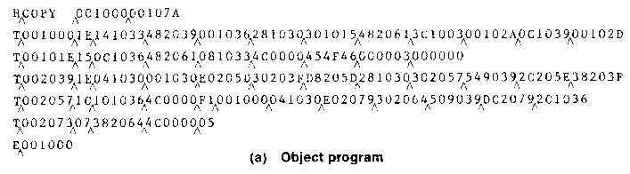
OBJECT PROGRAM

Slide 16
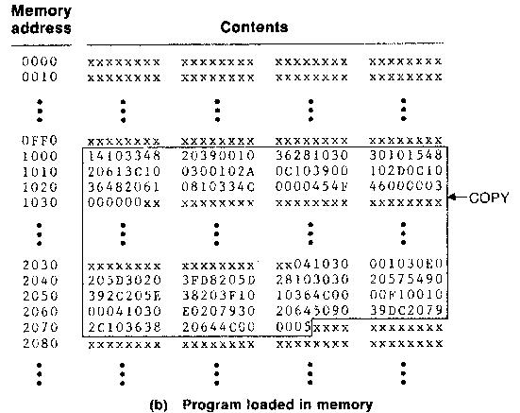
Format-1(a) (in PowerPoint)
Space for
2 inch x 2 inch
size Picture
Space for
2 inch x 2 inch
size Picture

Slide 17
OBJECT CODE REPRESENTATION
  Each byte of assembled code is given using its hexadecimal representation in character form
  Easy to read by human beings
  Each byte of object code is stored as a single byte
  Most machine store object programs in a binary form
  We must be sure that our file and device conventions do not cause some of the program bytes to be interpreted as control characters

Slide 18
A SIMPLE BOOTSTRAP LOADER
  When a computer is first tuned on or restarted, a special type of absolute loader, called bootstrap loader is executed
  This bootstrap loads the first program to be run by the computer -- usually an operating system

Slide 19
EXAMPLE (SIC BOOTSTRAP LOADER)
  The bootstrap itself begins at address 0
  It loads the OS starting address 0x80
  No header record or control information, the object code is consecutive bytes of memory

Slide 20
Begin
X=0x80 (the address of the next memory location to be loaded
Loop
A←GETC (and convert it from the ASCII character code to the value of the hexadecimal digit)
save the value in the high-order 4 bits of S
A←GETC
combine the value to form one byte A← (A+S)
store the value (in A) to the address in register X
X←X+1
End

Slide 21
SUBROUTINE GETC
GETC A←read one character
if A=0x04 then jump to 0x80
if A<48 then GETC
A ← A-48 (0x30)
if A<10 then return
A ← A-7
return

Slide 22
MACHINE-DEPENDENT LOADER FEATURES
Absolute Loader – Simple and efficient
Disadvantage is – programmer has to specify the starting address
One program to run – no problem – not for several
Difficult to use subroutine libraries efficiently

Slide 23
RELOCATION
Execution of the object program using any part of the available and sufficient memory
The object program is loaded into memory wherever there is room for it
The actual starting address of the object program is not known until load time

Slide 24
RELOCATING LOADERS
  Efficient sharing of the machine with larger memory and when several independent programs are to be run together
  Support the use of subroutine libraries efficiently

Slide 25
METHODS FOR SPECIFYING RELOCATION
  Use of modification record Refer Figure
  Use of relocation bit Refer Figure
    Each instruction is associated with one relocation bit
    These relocation bits in a Text record is gathered into bit masks

Slide 26
MODIFICATION RECORD
Modification record
  col 1: M
  col 2-7: relocation address
  col 8-9: length (halfbyte)
  col 10: flag (+/-)
  col 11-17: segment name
For complex machines
Also called RLD specification
  - Relocation and Linkage Directory

Slide 27
H_{Λ}COPY _{Λ}000000 001077
T_{Λ}000000 _{Λ}1D_{Λ}17202D_{Λ}69202D_{Λ}48101036_{Λ}…_{Λ}4B105D_{Λ}3F2FEC_{Λ}032010
T_{Λ}00001D_{Λ}13_{Λ}0F2016_{Λ}010003_{Λ}0F200D_{Λ}4B10105D_{Λ}3E2003_{Λ}454F46
T_{Λ}001035 _{Λ}1D_{Λ}B410_{Λ}B400_{Λ}B440_{Λ}75101000_{Λ}…_{Λ}332008_{Λ}57C003_{Λ}B850
T_{Λ}001053_{Λ}1D_{Λ}3B2FEA_{Λ}134000_{Λ}4F0000_{Λ}F1_{Λ}.._{Λ}53C003_{Λ}DF2008_{Λ}B850
T_{Λ}00070_{Λ}07_{Λ}3B2FEF_{Λ}4F0000_{Λ}05
M_{Λ}000007_{Λ}05+COPY
M_{Λ}000014_{Λ}05+COPY
M_{Λ}000027_{Λ}05+COPY
E_{Λ}000000
Figure
Object program with relocation by Modification records

Slide 28
RELOCATION BIT
For simple machines
Relocation bit
  - 0: no modification is necessary
  - 1: modification is needed

Slide 29
RELOCATION BIT
For simple machines
Relocation bit
  - 0: no modification is necessary
  - 1: modification is needed

Slide 30
Twelve-bit mask is used in each Text record - col:10-12 – relocation bits
  - since each text record contains less than 12 words
  - unused words are set to 0
  - any value that is to be modified during relocation must coincide with one of these 3-byte segments - line 210

Slide 31
H_{Λ}COPY _{Λ}000000 00107A
T_{Λ}000000_{Λ}1E_{Λ}FFC_{Λ}140033_{Λ}481039_{Λ}000036_{Λ}280030_{Λ}300015_{Λ}…_{Λ}3C0003 _{Λ} …
T_{Λ}00001E_{Λ}15_{Λ}E00_{Λ}0C0036_{Λ}481061_{Λ}080033_{Λ}4C0000_{Λ}…_{Λ}000003_{Λ}000000
T_{Λ}001039_{Λ}1E_{Λ}FFC_{Λ}040030_{Λ}000030_{Λ}…_{Λ}30103F_{Λ}D8105D_{Λ}280030_{Λ}...
T_{Λ}001057_{Λ}0A_{Λ} 800_{Λ}100036_{Λ}4C0000_{Λ}F1_{Λ}001000
T_{Λ}001061_{Λ}19_{Λ}FE0_{Λ}040030_{Λ}E01079_{Λ}…_{Λ}508039_{Λ}DC1079_{Λ}2C0036_{Λ}...
E_{Λ}000000
Object program with relocation by bit mask
- FFC - all ten words are to be modified
- E00 - first three records are to be modified

Slide 32
PROGRAM LINKING
Goal - Resolve the problems with EXTREF and EXTDEF from different control sections
Example - Program in Fig. 3.8 and object code in Figure (Refer)
Use modification records for both relocation and linking
    - address constant
    - external reference

Slide 33
EXTDEF (EXTERNAL DEFINITION
The EXTDEF statement in a control section names symbols, called external symbols, that are defined in this control section and may be used by other sections
Ex: EXTDEF BUFFER, BUFFEND, LENGTH (Refer Figure)
EXTDEF LISTA, ENDA (Refer Figure)

Slide 34
EXTREF (EXTERNAL REFERENCE)
The EXTREF statement names symbols used in this (present) control section and are defined elsewhere
  Ex: EXTREF RDREC, WRREC (Refer Figure) EXTREF LISTB, ENDB, LISTC, ENDC (Refer Figure)

Slide 35
HOW TO IMPLEMENT THESE…
The assembler must include information in the object program that will cause the loader to insert proper values where they are required – in the form of
- Define record
- Refer record

Slide 36
DEFINE RECORD
  Col. 1 D
  Col. 2-7 Name of external symbol defined in this control section
  Col. 8-13 Relative address within this control section (hexadecimal)
  Col.14-73 Repeat information in Col. 2-13 for other external symbols
      - D LISTA 000040 ENDA 000054
      - D LISTB 000060 ENDB 000070

Slide 37
REFER RECORD
  Col. 1 R
  Col. 2-7 Name of external symbol referred to in this control section
  Col. 8-73 Name of other external reference symbols
R LISTB ENDB LISTC ENDC
R LISTA ENDA LISTC ENDC
R LISTA ENDA LISTB ENDB

Slide 38
0000 PROGA START 0
EXTDEF LISTA, ENDA
EXTREF LISTB, ENDB, LISTC, ENDC
.
.
0020 REF1 LDA LISTA 03201D
0023 REF2 +LDT LISTB+4 77100004
0027 REF3 LDX #ENDA-LISTA 050014
.
.
0040 LISTA EQU *
0054 ENDA EQU *
0054 REF4 WORD ENDA-LISTA+LISTC 000014
0057 REF5 WORD ENDC-LISTC-10 FFFFF6
005A REF6 WORD ENDC-LISTC+LISTA-1 00003F
005D REF7 WORD ENDA-LISTA-(ENDB-LISTB) 000014
0060 REF8 WORD LISTB-LISTA FFFFC0
END REF1

Slide 39
0000 PROGB START 0
EXTDEF LISTB, ENDB
EXTREF LISTA, ENDA, LISTC, ENDC
.
.
0036 REF1 +LDA LISTA 03100000
003A REF2 LDT LISTB+4 772027
003D REF3 +LDX #ENDA-LISTA 05100000
.
.
0060 LISTB EQU *
0070 ENDB EQU *
0070 REF4 WORD ENDA-LISTA+LISTC 000000
0073 REF5 WORD ENDC-LISTC-10 FFFFF6
0076 REF6 WORD ENDC-LISTC+LISTA-1 FFFFFF
0079 REF7 WORD ENDA-LISTA-(ENDB-LISTB) FFFFF0
007C REF8 WORD LISTB-LISTA 000060
END

Slide 40
0000 PROGB START 0
EXTDEF LISTB, ENDB
EXTREF LISTA, ENDA, LISTC, ENDC
.
.
0036 REF1 +LDA LISTA 03100000
003A REF2 LDT LISTB+4 772027
003D REF3 +LDX #ENDA-LISTA 05100000
.
.
0060 LISTB EQU *
0070 ENDB EQU *
0070 REF4 WORD ENDA-LISTA+LISTC 000000
0073 REF5 WORD ENDC-LISTC-10 FFFFF6
0076 REF6 WORD ENDC-LISTC+LISTA-1 FFFFFF
0079 REF7 WORD ENDA-LISTA-(ENDB-LISTB) FFFFF0
007C REF8 WORD LISTB-LISTA 000060
END

Slide 41
H PROGA 000000 000063
D LISTA 000040 ENDA 000054
R LISTB ENDB LISTC ENDC
.
.
T 000020 0A 03201D 77100004 050014
.
.
T 000054 0F 000014 FFFF6 00003F 000014 FFFFC0
M000024 05+LISTB
M000054 06+LISTC
M000057 06+ENDC
M000057 06 -LISTC
M00005A06+ENDC
M00005A06 -LISTC
M00005A06+PROGA
M00005D06-ENDB
M00005D06+LISTB
M00006006+LISTB
M00006006-PROGA
E000020

Slide 42
H PROGB 000000 00007F
D LISTB 000060 ENDB 000070
R LISTA ENDA LISTC ENDC
.
.
T 000036 0B 03100000 772027 05100000
.
.
T 000007 0F 000000 FFFFF6 FFFFFF FFFFF0 000060
M000037 05+LISTA
M00003E 06+ENDA
M00003E 06 -LISTA
M000070 06 +ENDA
M000070 06 -LISTA
M000070 06 +LISTC
M000073 06 +ENDC
M000073 06 -LISTC
M000073 06 +ENDC
M000076 06 -LISTC
M000076 06+LISTA

Slide 43
H PROGC 000000 000051
D LISTC 000030 ENDC 000042
R LISTA ENDA LISTB ENDB
.
T 000018 0C 03100000 77100004 05100000
.
T 000042 0F 000030 000008 000011 000000 000000
M000019 05+LISTA
M00001D 06+LISTB
M000021 06+ENDA
M000021 06 -LISTA
M000042 06+ENDA
M000042 06 -LISTA
M000042 06+PROGC
M000048 06+LISTA
M00004B 06+ENDA
M00004B 006-LISTA
M00004B 06-ENDB
M00004B 06+LISTB
M00004E 06+LISTB
M00004E 06-LISTA
E

Slide 44
Program Linking Example
Refer Figure 3.5.2
Load address for control sections
  PROGA 004000 63
  PROGB 004063 7F
  PROGC 0040E2 51

Slide 45
Load address for symbols
  LISTA: PROGA+0040=4040
  LISTB: PROGB+0060=40C3
  LISTC: PROGC+0030=4112
REF4 in PROGA
ENDA-LISTA+LISTC=14+4112=4126
(ENDA-LISTA = 14 (4054-4040)
T0000540F000014FFFFF600003F000014FFFFC0
M00005406+LISTC

Slide 46
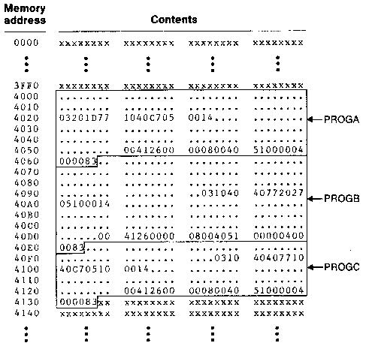
Figure 3.5.1: Programs form the above figure after linking and loading

Slide 47
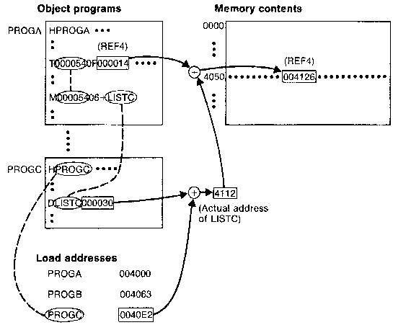
Figure 3.5.2: relocation and linking operations
performed on REF4 from PROGA

Slide 48
ALGORITHM AND DATA STRUCTURES FOR A LINKING LOADER
Linking Loader uses two-passes logic
- Pass 1: assign addresses to all external symbols
- Pass 2: perform the actual loading, relocation, and linking
ESTAB (external symbol table) – main data structure for a linking loader

Slide 49
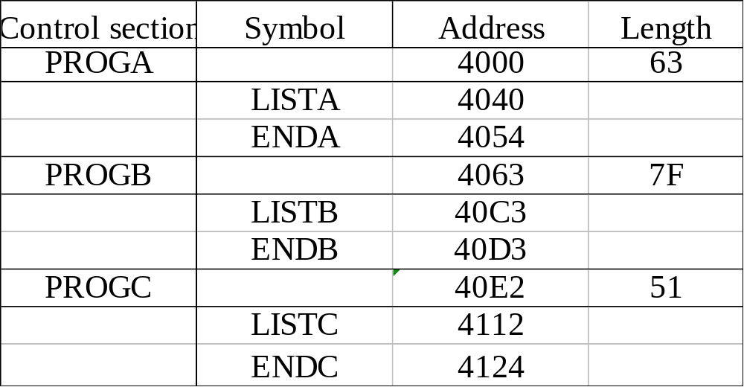
ESTAB FOR THE EXAMPLE GIVEN

Slide 50
PROGRAM LOGIC FOR PASS 1
Pass 1:
  - Assign addresses to all external symbols
Variables & Data structures
- PROGADDR (program load address) from OS
- CSADDR (control section address)
- CSLTH (control section length
- ESTAB
Refer Algorithm for Pass 1 of LL in Fig. 3.11(a)
  - Process Define Record

Slide 51
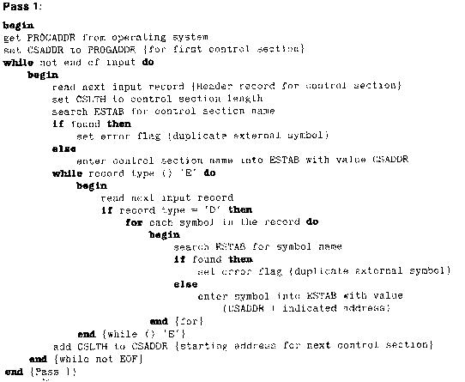

Slide 52
PROGRAM LOGIC FOR PASS 2
Pass 2:
  - Perform the actual loading, relocation, and linking
Modification record
  - Lookup the symbol in ESTAB
End record for a main program
  - Transfer address
Refer Algorithm for Pass 2 of LL in Fig. 3.11(b)
  - Process Text record and Modification record

Slide 53
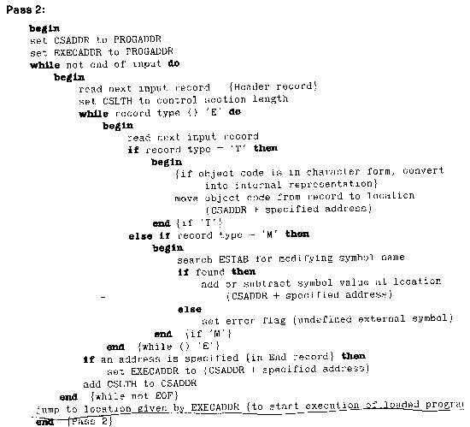

Slide 54
IMPROVE EFFICIENCY, HOW?
Use of local searching instead of multiple searches of ESTAB for the same symbol
  - assign a reference number to each external symbol
  - the reference number is used in Modification records
Implementation
  - 01: control section name
  - other: external reference symbols
Example - Refer Figure

Slide 55
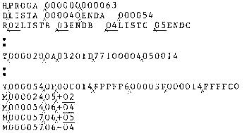

Slide 56
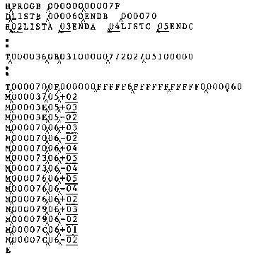

Slide 57
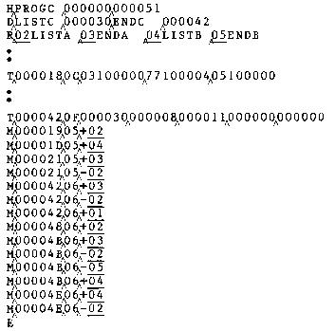

Slide 58
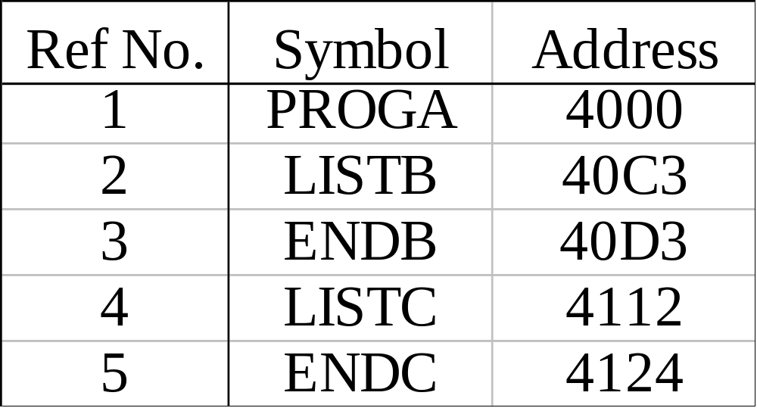
SYMBOL AND ADDRESSES IN PROGA
PROGA

Slide 59
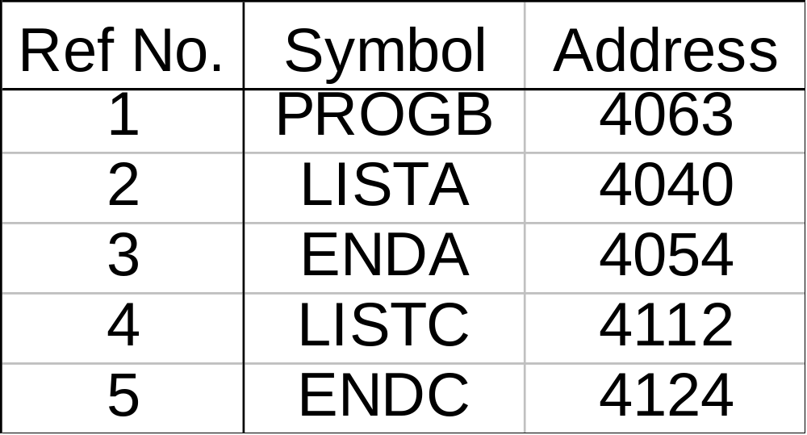
SYMBOL AND ADDRESSES IN PROGB
PROGB

Slide 60
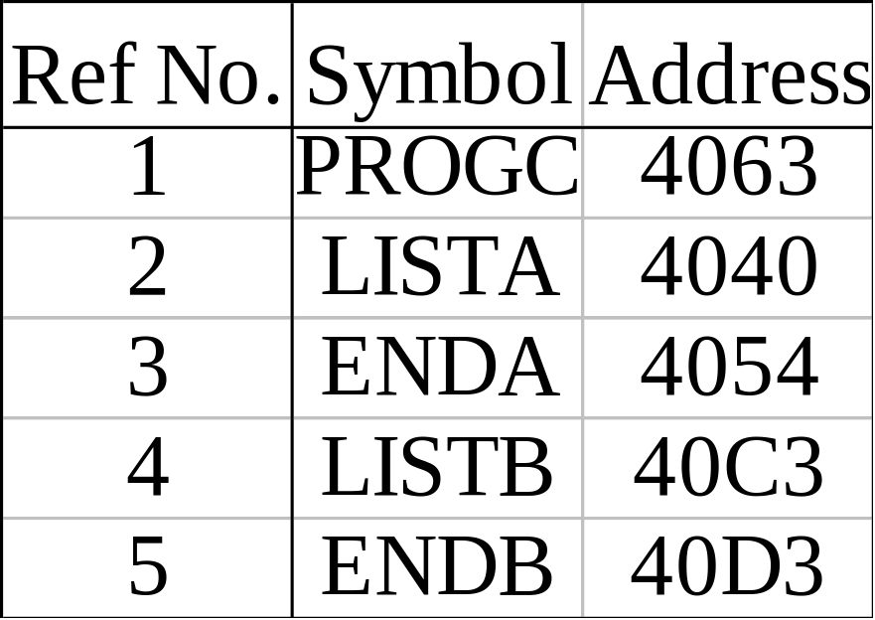
SYMBOL AND ADDRESSES IN PROGC
PROGC

Slide 61
ADVANTAGE OF REFERENCE-NUMBER
The main advantage of reference number mechanism is that it avoids multiple searches of ESTAB for the same symbol during the loading of a control section.

Slide 62
MACHINE-INDEPENDENT LOADER FEATURES
Features that are not directly related to machine architecture and design
- Automatic Library Search
- Loader Options

Slide 63
AUTOMATIC LIBRARY SEARCH
This feature allows a programmer to use standard subroutines without explicitly including them in the program to be loaded
The routines are automatically retrieved from a library as they are needed during linking

Slide 64
IMPLEMENTATION
Allows programmer to use subroutines from one or more libraries
The subroutines called by the program being loaded are automatically fetched from the library, linked with the main program and loaded
The loader searches the library or libraries specified for routines that contain the definitions of these symbols in the main program

Slide 65
LOADER OPTIONS
Allow the user to specify options that modify the standard processing
Specified using a command language
Specified as a part of job control language that is processed by the operating system
Specified using loader control statements in the source program.

Slide 66
EXAMPLE OPTIONS
INCLUDE program-name (library-name) - read the designated object program from a library
DELETE csect-name – delete the named control section from the set pf programs being loaded
CHANGE name1, name2 - external symbol name1 to be changed to name2 wherever it appears in the object programs
LIBRARY MYLIB – search MYLIB library before standard libraries
NOCALL STDDEV, PLOT, CORREL – no loading and linking of unneeded routines

Slide 67
EXAMPLE
LIBRARY UTLIB
INCLUDE READ (UTLIB)
INCLUDE WRITE (UTLIB)
DELETE RDREC, WRREC
CHANGE RDREC, READ
CHANGE WRREC, WRITE
NOCALL SQRT, PLOT

Slide 68
LOADER DESIGN OPTIONS
Common alternatives for organizing the loading functions, including relocation and linking
Linking Loaders – Perform all linking and relocation at load time
Other Alternatives
Linkage editors – Perform linking prior to load time
Dynamic linking – Linking function is performed at execution time

Slide 69
LINKING LOADERS
Object Program(s)
The source program is first assembled or compiled, producing an object program. A linking loader performs all linking and loading operations, and loads the program into memory for execution
Library
Linking loader
Memory
Processing of an Object program using LL

Slide 70
LINKAGE EDITORS
Object Program (s)
Linkage editor
Library
Linked program
Processing of an Object program using LE
Relocating loader
Memory

Slide 71
LINKAGE EDITORS
A linkage editor, produces a linked version of the program – often called a load module or an executable image – which is written to a file or library for later execution
The linked program produced is generally in a form that is suitable for processing by a relocating loader.

Slide 72
SOME USEFUL FUNCTIONS…
An absolute object program can be created, if starting address is already known
New versions of the library can be included without changing the source program
Linkage editors can also be used to build packages of subroutines or other control sections that are generally used together
Linkage editors often allow the user to specify that external references are not to be resolved by automatic library search – linking will be done later by linking loader – linkage editor + linking loader – savings in space

Slide 73
DYNAMIC LINKING
The scheme that postpones the linking function until execution
A subroutine is loaded and linked to the rest of the program when it is first called – usually called dynamic linking, dynamic loading or load on call

Slide 74
ADVANTAGES…
Allow several executing programs to share one copy of a subroutine or library
In an object oriented system, dynamic linking makes it possible for one object to be shared by several programs
Dynamic linking provides the ability to load the routines only when (and if) they are needed
The actual loading and linking can be accomplished using operating system service request – Refer Figure

Slide 75
BOOTSTRAP LOADERS
How is the loader itself loaded into the memory ?
When computer is started – with no program in memory, a program present in ROM ( absolute address) can be made executed – may be OS itself or A Bootstrap loader, which in turn loads OS and prepares it for execution.
The first record ( or records) is generally referred to as a bootstrap loader – makes the OS to be loaded
Such a loader is added to the beginning of all object programs that are to be loaded into an empty and idle system

Slide 76
IMPLEMENTATION EXAMPLES…
Brief description of loaders and linkers for actual computers
They are
MS-DOS Linker - Pentium architecture
SunOS Linkers - SPARC architecture
Cray MPP Linkers – T3E architecture

Slide 77
MS-DOS LINKER
Microsoft MS-DOS linker for Pentium and other x86 systems
Most MS-DOS compilers and assemblers (MASM) produce object modules - .OBJ files
MS-DOS LINK is a linkage editor that combines one or more object modules to produce a complete executable program - .EXE file

Slide 78
MS-DOS OBJECT MODULE
Record Types Description
THEADR Translator Header
TYPDEF,PUBDEF, EXTDEF External symbols and references
LNAMES, SEGDEF, GRPDEF Segment definition and grouping
LEDATA, LIDATA Translated instructions and data
FIXUPP Relocation and linking information
MODEND End of object module

Slide 79
SUNOS LINKERS
SunOS provides two different linkers – link-editor and run-time linker
Link-editor is invoked in the process of assembling or compiling a program – produces a single output module – one of the following types (next slide)
An object module contains one or more sections – representing instructions and data area from the source program, relocation and linking information, external symbol table

Slide 80
TYPES OF OBJECT MODULE
A relocatable object module – suitable for further link-editing
A static executable – with all symbolic references bound and ready to run
A dynamic executable – in which some symbolic references may need to be bound at run time
A shared object – which provides services that can be bound at run time to one ore more dynamic executables

Slide 81
RUN-TIME LINKER
Uses dynamic linking approach
Run-time linker binds dynamic executables and shared objects at execution time
Performs relocation and linking operations to prepare the program for execution

Slide 82
CRAY MPP LINKER
Cray MPP (massively parallel processing ) Linker
T3E system contains large number of parallel processing elements (PEs) – Each PE has local memory and has access to remote memory (memory of other PEs)
The processing is divided among PEs - contains shared data and private data
The loaded program gets copy of the executable code, its private data and its portion of the shared data

Slide 83
Cray MPP (massively parallel processing ) Linker
T3E system contains large number of parallel processing elements (PEs) – Each PE has local memory and has access to remote memory (memory of other PEs)
The processing is divided among PEs - contains shared data and private data
The loaded program gets copy of the executable code, its private data and its portion of the shared data

Slide 84
PE0
PE1
PEn
Code
Code
Code
Private data
Private data
……………
Private data
Shared data-0
Shared data-1
Shared data-n
T3E program loaded on multiple PEs

Slide 85
THIS CHAPTER GAVE YOU…
Basic Loader Functions
Machine-Dependent Loader Features
Machine-Independent Loader Features
Loader Design Options
Implementation Examples

Slide 86
Thank you all

